Slide 1
Data Analytics - Group 7
Factors Lead to Heart Disease

Slide 2
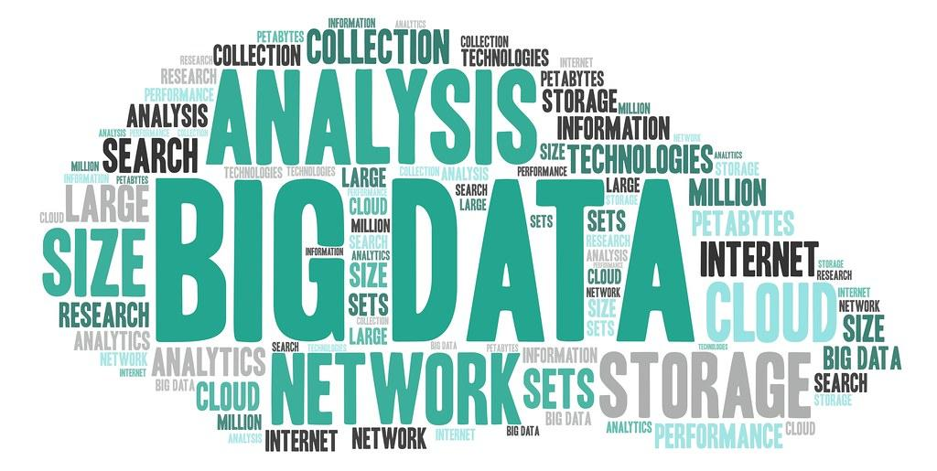
CONTENTS
Objective
Overview
Data Sources
Analytical Questions
Predictive Analytics
Conclusion

Slide 3
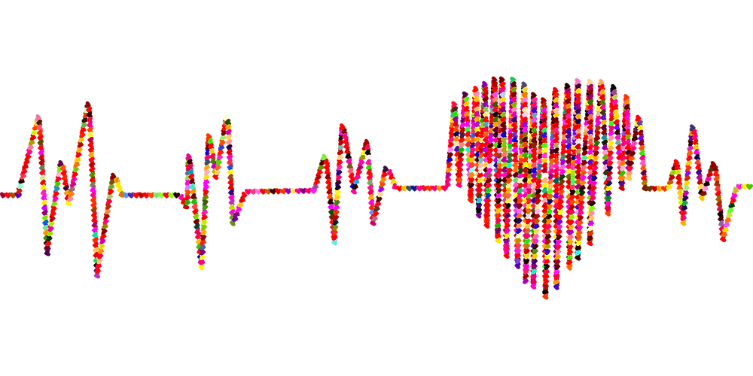
PROJECT OBJECTIVE:
Analysing which indicators are factors for heart disease using machine learning model

Slide 4
DATA EXPLORATION & PRELIMINARY ANALYSIS

Slide 5
Overview
Data Preparation
ETL through Pandas
SQL database using PgAdmin
Model Building
Machine Learning
Testing & Evaluation
Logistic Regression
Random Forest
Conclusion & Data Visualization
Tableau Storyboard

Slide 6
Data Sources & Resources
Data Source: heart_disease_key_indicators.csv
Software: Python 3.7.10, Visual Studio Code 1.38.1, Jupyter Notebook, Anaconda3, PgAdmin.
Resources: https://www.kaggle.com/datasets?search=heart+disease.

Slide 7

Analytical Questions
What are the key indicators that lead to heart disease ?
What factors had the greatest influence on a person developing heart disease and in what proportions ?
Can a machine learning model accurately predict whether a person will develop heart disease based on the data provided ?

Slide 8
EDA

Slide 9
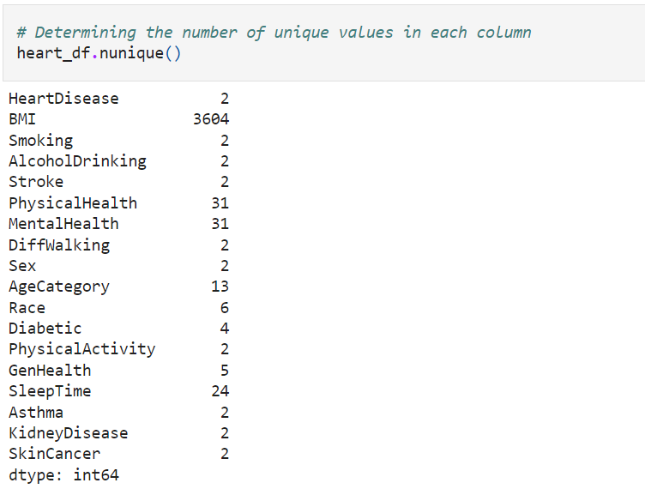
The variables types are
Binary – HeartDisease (target),Smoking,
AlcoholDrinking, Stroke, Diffwalking,
Sex, PhysicalActivity, Asthma,
KidneyDisease, SkinCancer
Categorical – Race, Diabetic,
GenHealth
Continuous – BMI, PhysicalHealth ,
MentalHealth , Age Category, Sleeptime

Slide 10
Import and Get to know the Data | Data Cleaning | Distributions and Relationship
Importing libraries and files for exploratory data analysis Creating data frame and checking number of columns and rows. | Checking the data types. Checking the data characters mistakes. Checking the null values. Checking and removing the duplicates. Transforming the target variable. | Loading data by Postgres Target variable visualization Other variable against target variable visualizations. Correlation Visualization.

Slide 11
Why we used
Heart disease are the number one cause of death globally.
There are many factors have been identified which lead to heart disease.
Exploratory and Descriptive data analysis targeting the health care professional.

Slide 12
Exploratory Analysis

Slide 13
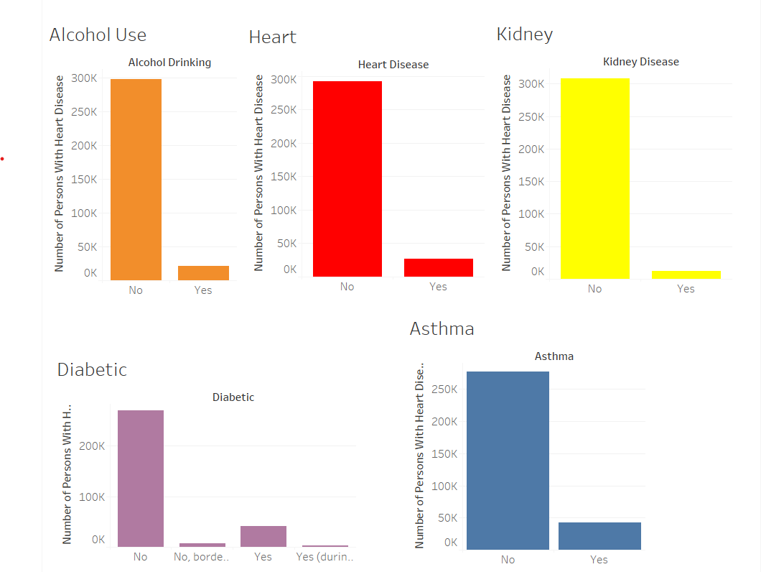
Conclusion
Findings
Tableau Storyboard - https://public.tableau.com/app/profile/ethan.mcbride/viz/HeartDiseaseKeyIndicatorsDashboard/GeneralOverview

Slide 14








The Team
Ethan McBride
Andres Pombo
Sergei Zhukov
Marian Salgadoe
Thank you

